Slide 1
Integrating Education Technologies and e-Learning Pedagogies in Higher Education
George Dafoulas Computer Science Department
School of Science and Technology

Slide 2
Agenda
My academic journey
Background on Middlesex University
The talk’s theme – four brief stories
Global Campus – supporting an e-learning pedagogy
Second Life – using virtual worlds in education
Social Media – exploiting learning analytics
Google Glasses – exploring the possibilities of ubiquitous computing

Slide 3
My academic journey
Arrived at UMIST on September 17, 1994
BSc focus on databases
MPhil focus on virtual teams (dynamic role allocation)
PhD focus online employment contracts
PCAP focus on e-learning and e-assessment
Moved to Middlesex on February 3, 2004
MBA focus on HR issues in remote training
MA focus on joint delivery of academic programmes
Teaching Fellow focus on innovation in LTA
Senior Teaching Fellow focus on quality issues in HE
Programme Leader for Business Information Systems
Director of Programmes in Computer Science Department
Research: e-learning, global software development, CSCW

Slide 4
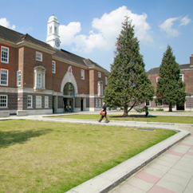
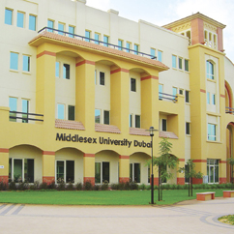
Middlesex University: A Global Education
Campuses in London, Dubai and Mauritius
Students from over 100 countries worldwide
Internationally focused teaching
Academic expertise with an international outlook – preparing you to compete in a global jobs market
Opportunities to study at our overseas campuses

Slide 5
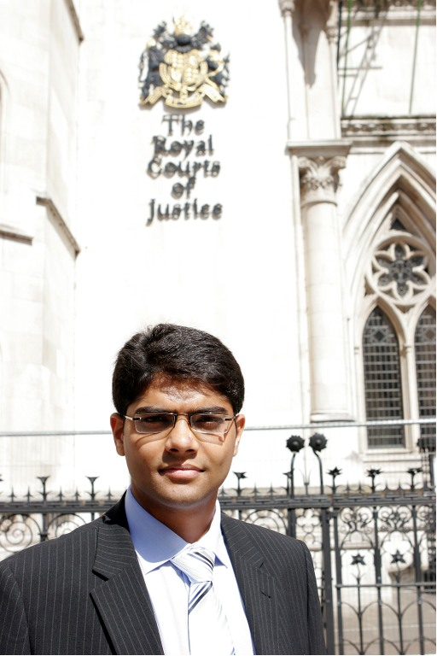
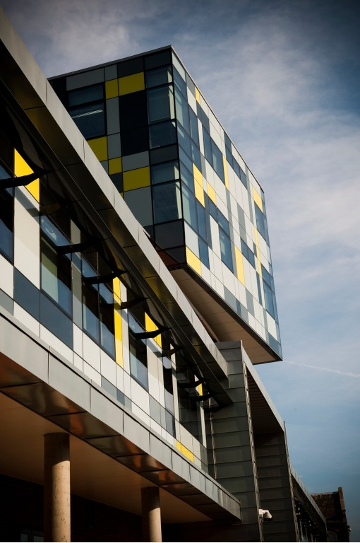
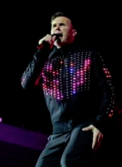
Our Schools
School of Art and Design | Business School | School of Health and Education
School of Law | School of Media and Performing Arts | School of Science and Technology
Award-winning students
Real world research and collaboration
Excellent research reputations and partnerships
Academics who are experts in their field
Outstanding facilities
Live industry projects
Notes:
Before moving on to speak about Science and Technology, I would like to give an overview of our other schools…
Art and Design – Our Art and Design students continuously win awards for their work including Final Year animation student Clive Shaw, who won a top animation award for his ‘Girls and Boys’ animation, judged by Simpsons and Futurama creator Matt Groening.
Business School – Research Impact: The work of our researchers has made a significant impact in the real world, having been used to help several governments shape policy, and business and organisations to take a fresh look at the way they do business.
This means that both our undergraduate and postgraduate students benefit from being taught by expert academics who are working at the cutting edge of their field. The curriculum taught within our courses is developed on the basis of the innovative work being undertaken by research academics that are actively extending the boundaries of understanding within their fields.
Health and Education – Our close partnerships with schools, hospitals, local authorities, the NHS and Teaching Agency ensure that our health and education courses reflect what these partners will be looking for in the future, ensuring that our graduates have very high employability rates.
Law – Prof. Castellino is Dean of School and a renowned researcher and commentator on issues concerning public international law and human rights law, including speaking on United Nations panels. Research contributions by our criminologists, sociologists and social policy analysts have been pioneering and internationally excellent. The School’s constituent subjects have an impressive history of winning competitive external funding, including from the ESRC, the AHRC, the British Academy, the Equality and Human Rights Commission, the Joseph Rowntree Foundation, the European Union, government departments and international organisations.
Media and Performing Arts – Following on from the opening of our £80 million art, design and media facility - the Grove building in the 2011/12 academic year, we are making a further £7.5 million investment in performing arts and education facilities.

Slide 6
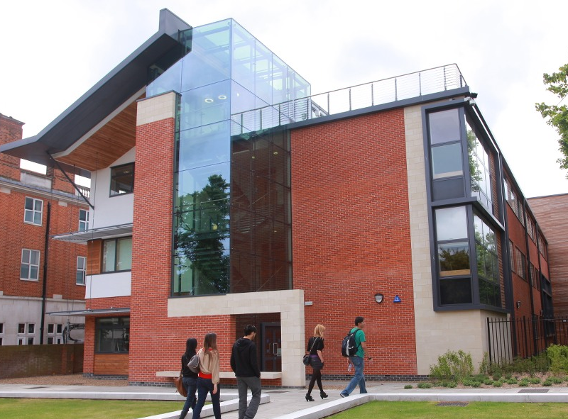
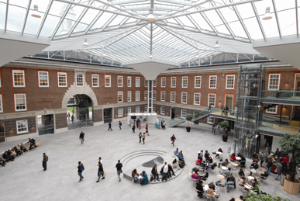
The Hendon Campus
One of London’s biggest campuses
Just 25 minutes from the shops, bars, theatres, galleries, parks and museums of central London, but one of the safest University locations in London.
35,000 students in London and overseas
Over £200million investment in creating one of London’s biggest and best-equipped campuses
Specialist teaching spaces, labs, studios and workshops

Slide 7
Today’s talk…
Integrating Education Technologies and e-Learning Pedagogies in Higher Education
Based on four brief stories bringing together the past, the present, the future:
Global Campus – supporting an e-learning pedagogy
Second Life – using virtual worlds in education
Social Media – exploiting learning analytics
Google Glasses – exploring the possibilities of ubiquitous computing

Slide 8
First story: Global Campus – supporting an e-learning pedagogy
Global Campus was the leading e-Learning Program in the UK making Middlesex University one of the pioneering British institutions in distance education. Initially funded by the UKeU Global Campus brought traditional learning to remote locations following an English curriculum. It was one of the few established projects involving blended teaching at both undergraduate and postgraduate level. Locations included China, Hong Kong, Egypt, Vietnam, Singapore, Lebanon, and Cyprus (+3 London campuses).
Local Support Centres (LSC)
Tutor support
Labs & assessment centres
e-Learning material
Global Campus CD
OASIS, WebCT VLE + PAM
Module Readers (text books MU Press)
Middlesex University participation
LSC validation
SCATE pedagogical model
Tutor training
Curriculum Leader visits to LSC
Module Leader support

Slide 9
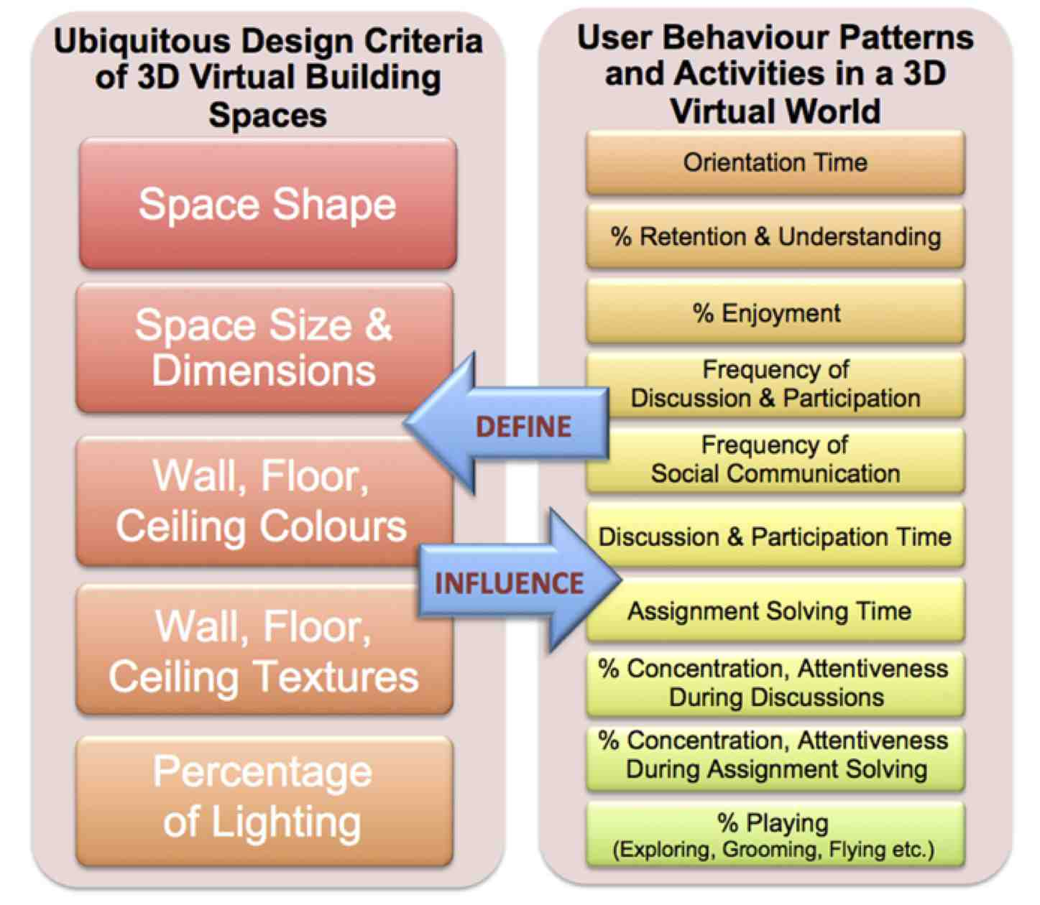
Second story: Second Life – using virtual worlds in education
Aim: Proposing a methodology for deriving guidelines for alignment of user behavioural patterns inside 3D virtual worlds with best design principles, which can be used to enhance the 3D environments’ spaces and hence augment users’ behaviour inside them.
Behavioural patterns in virtual worlds (George)
Architectural features in virtual spaces (Noha)
Ubiquitous 3D spaces (Martin)

Slide 10
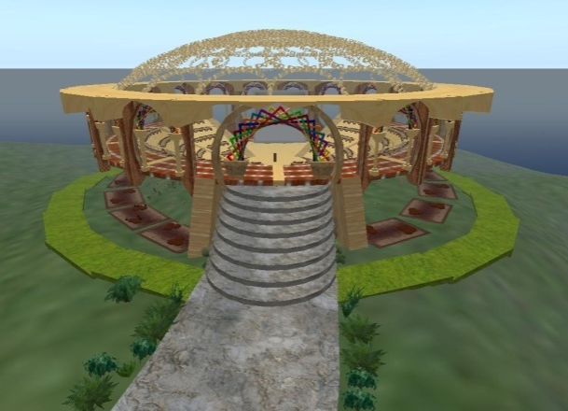
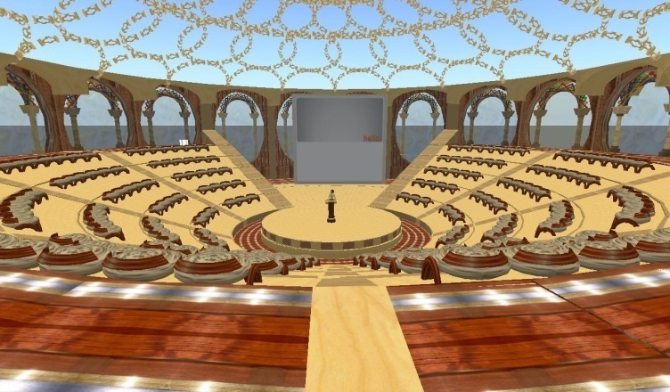
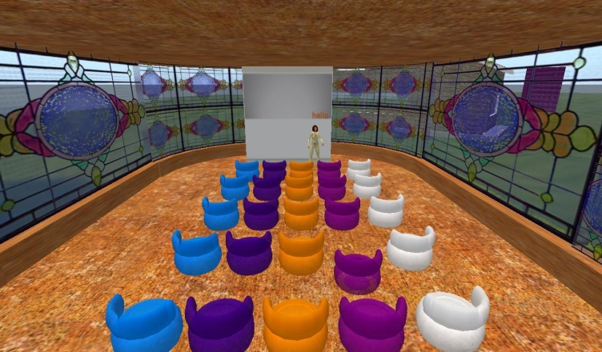
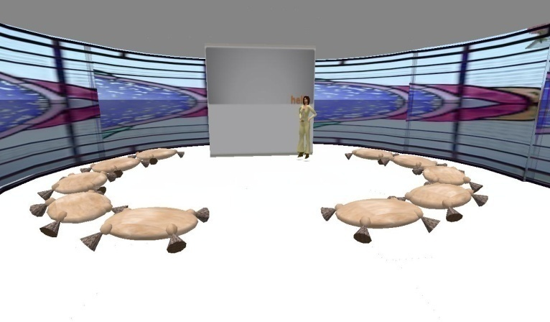
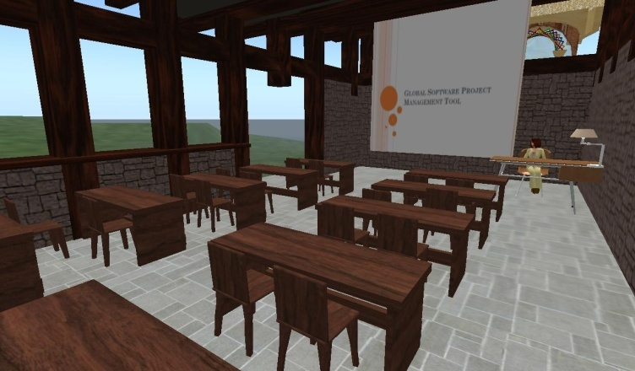
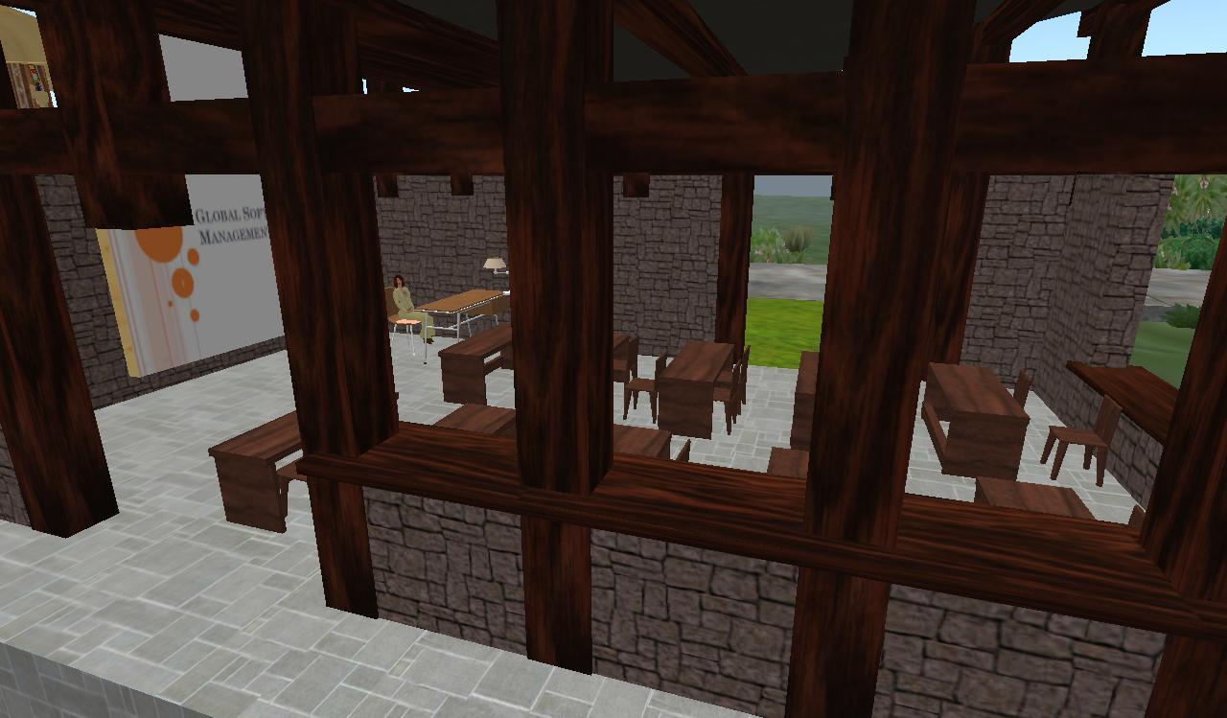
2. The DaCT village – learning modes
Amphitheatre
Seminar hall
Classroom

Slide 11
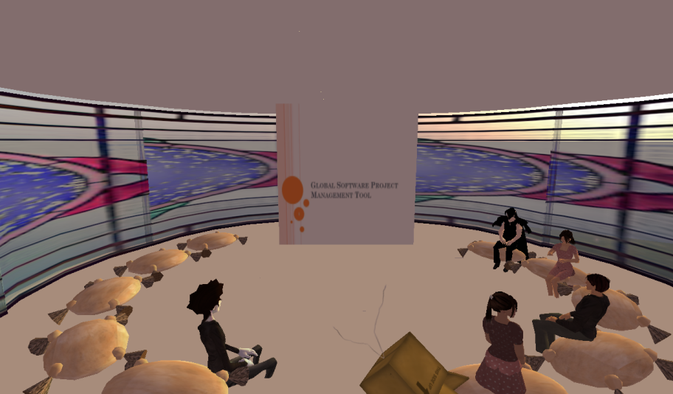
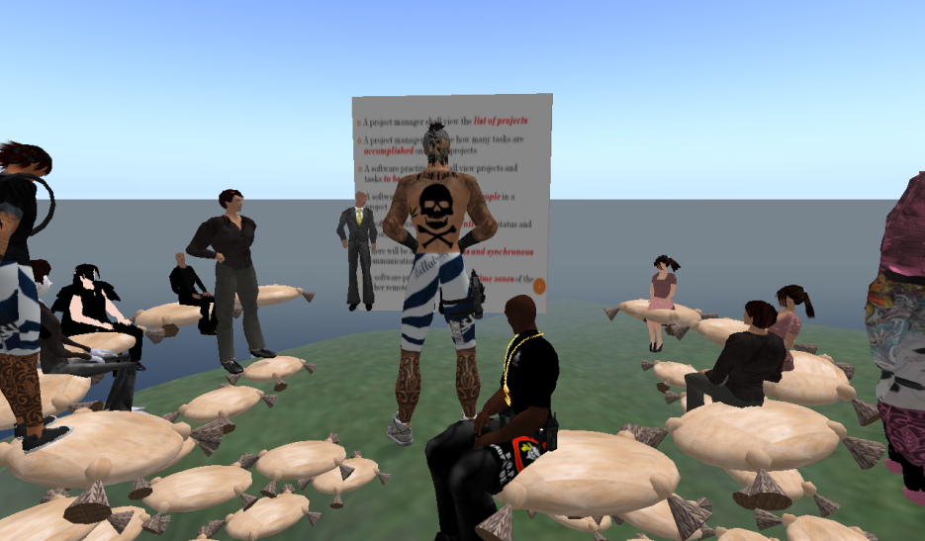
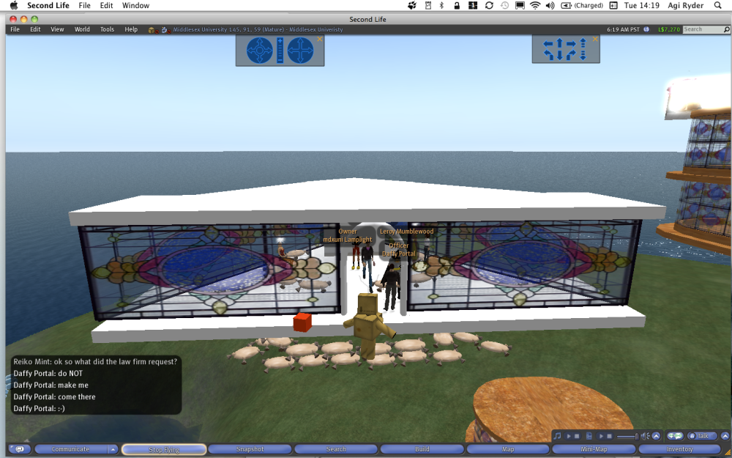
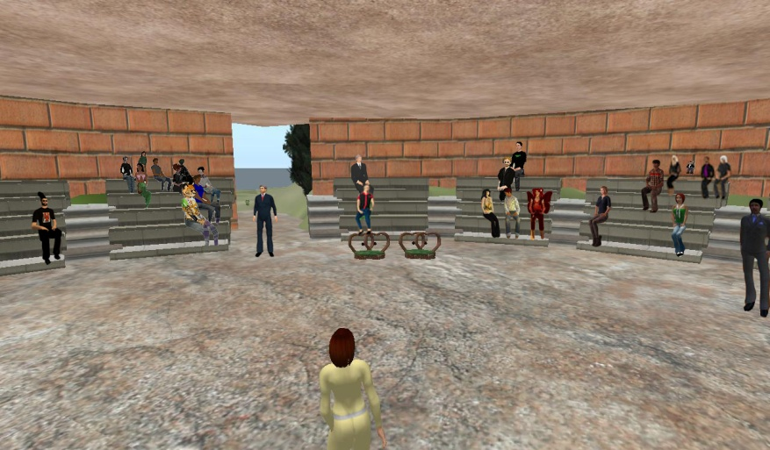
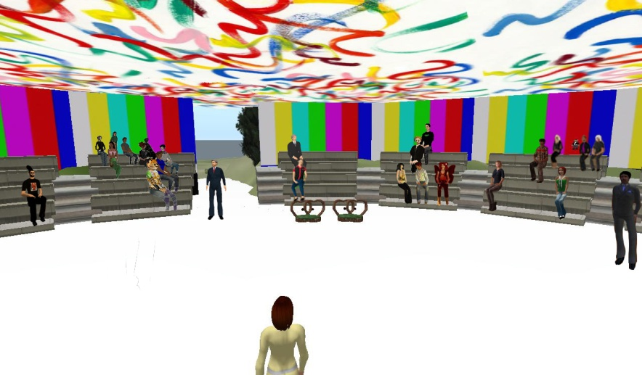
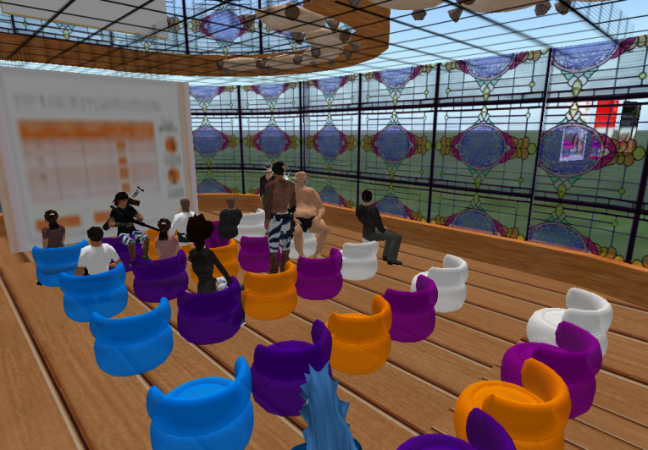
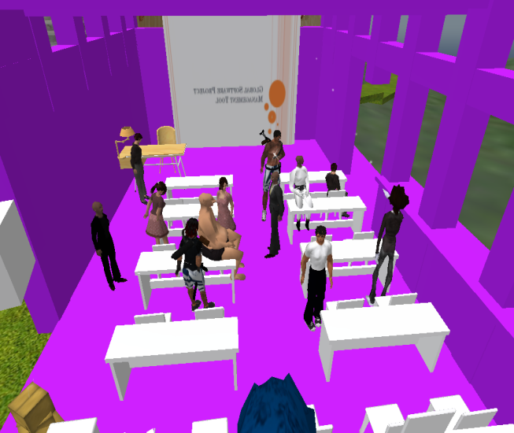
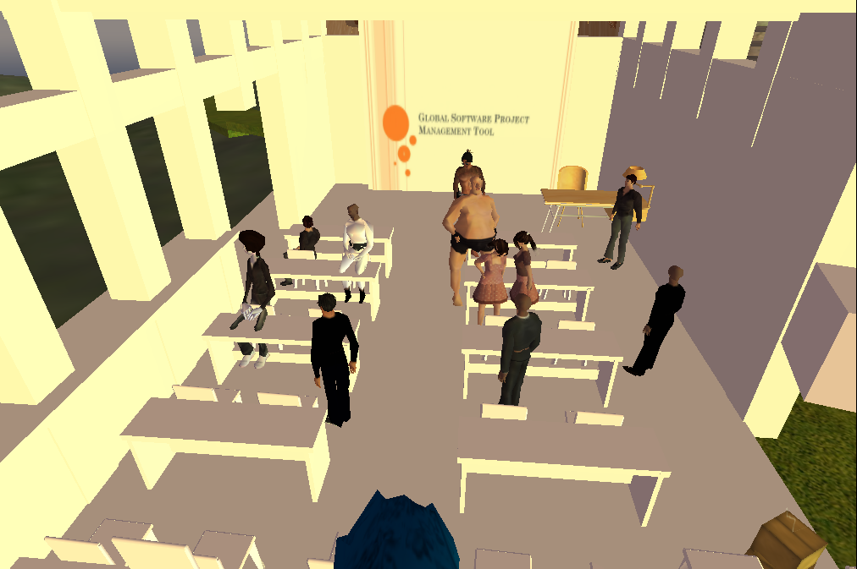
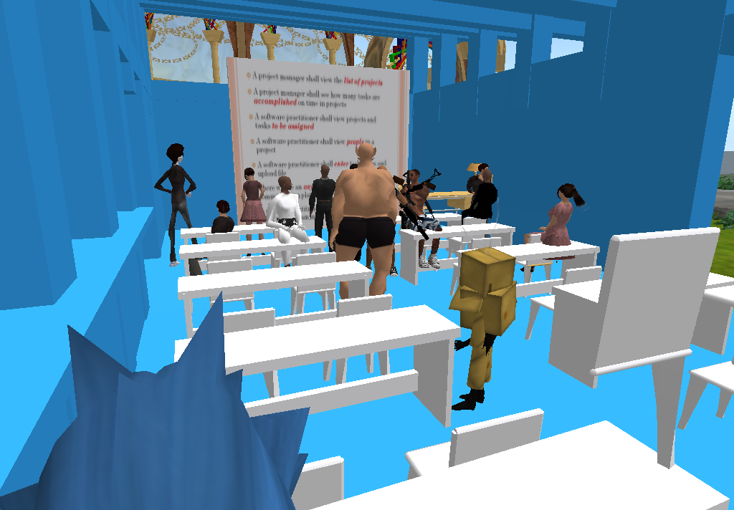
Shapes
Texture
Colour

Slide 12
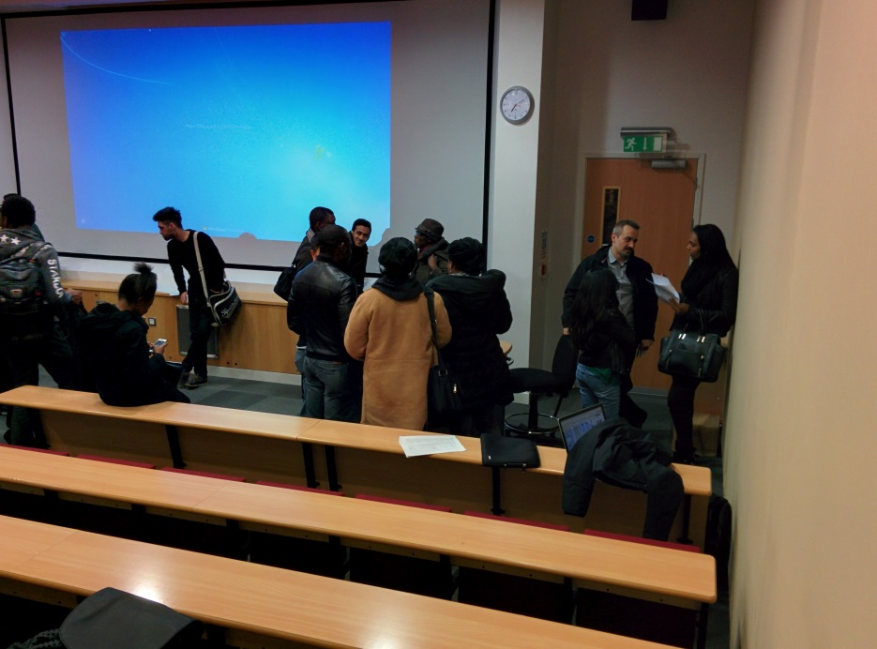
Third story: Social Media – exploiting learning analytics
Aim: To improve student satisfaction and perceived support
Facebook was used for group collaboration and reporting
Twitter was used for pair micro-blogging and reflection
LinkedIn was used as a learning journal and individual progress diary
135 Students over 7 lab sessions
Permanent base in H102; Tues 9-5 & Thur 12-7
24 groups on Facebook & 65 groups on Twitter
Weeks 1-12 = Facebook for groups / LinkedIn for individuals
Week 13-24 = Twitter for pairs / LinkedIn for individuals
Lecture 6pm Monday

Slide 13
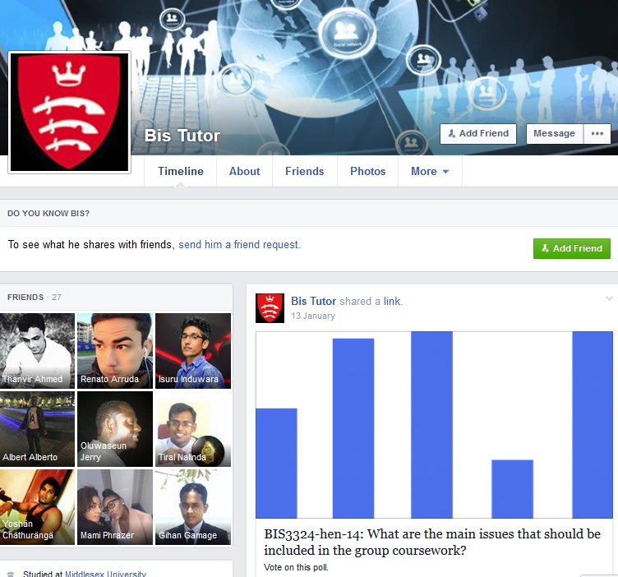
Facebook
Each week new tasks were given to each group
Students were encouraged to to explain how they managed their project
Students were required to demonstrate progress and share good practice
Individuals were requested to interact with pages of other groups and modules

Slide 14
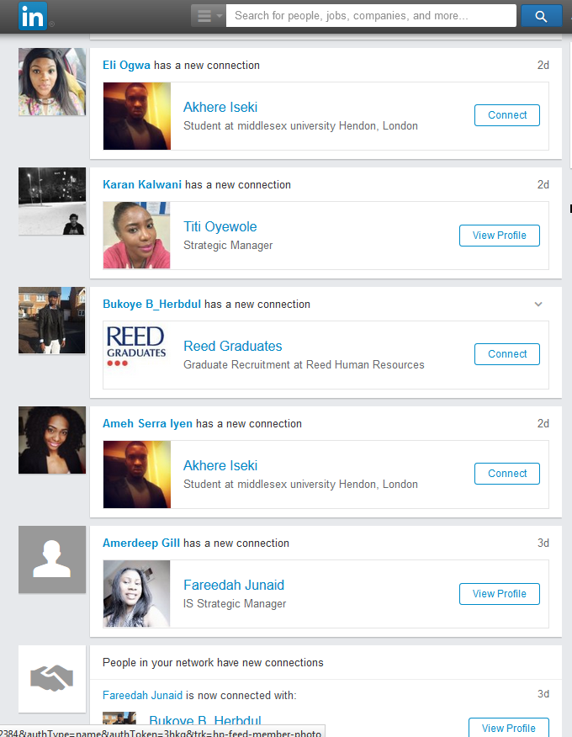
LinkedIn
Each week a new project added to their portfolio
Students encouraged to develop their profile and make connections
Offers of job interviews to students
Dramatically altered other students approach. e.g. Photo’s
Employability Lecture with Dell HR

Slide 15
Twitter
Pairs made 3 posts each week
Each group followed the BIS3324 Tutor account & each others progress through their feeds
Extremely efficient and effective method for the distribution and sharing of learning materials
Use of re-tweets and favourites provided students with positive feedback

Slide 16
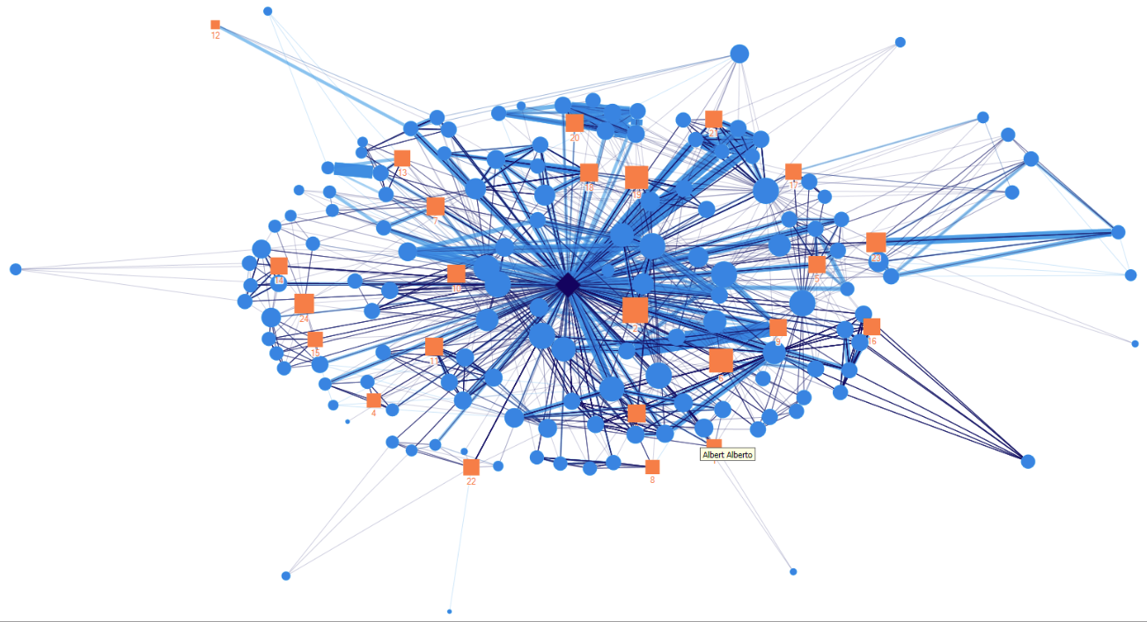
BIS3324 Tutor Account

Slide 17
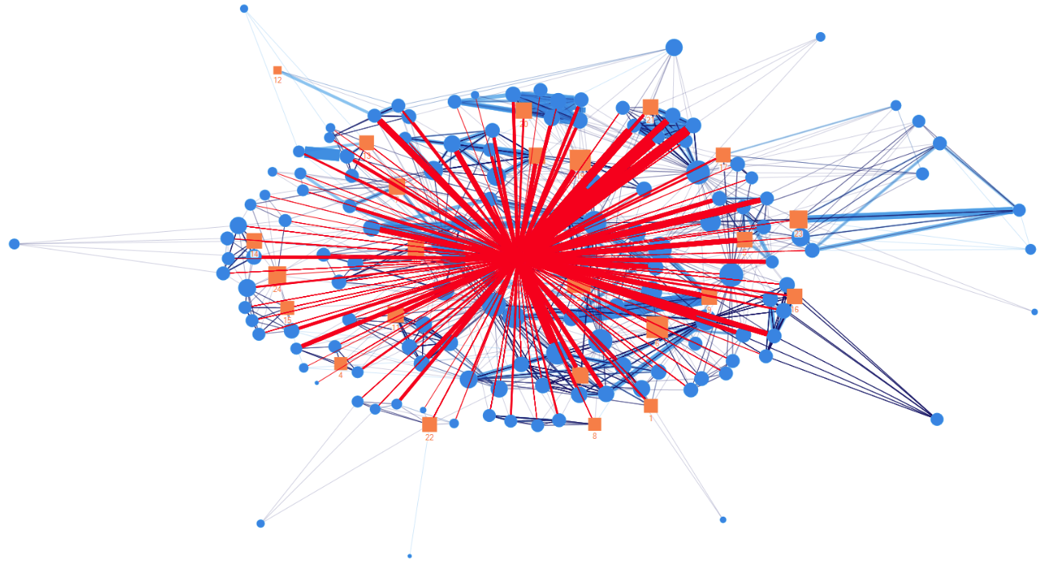
BIS3324 Tutor Influence

Slide 18
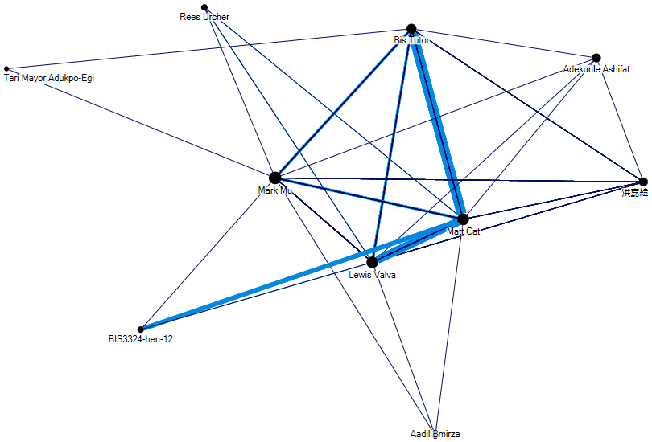
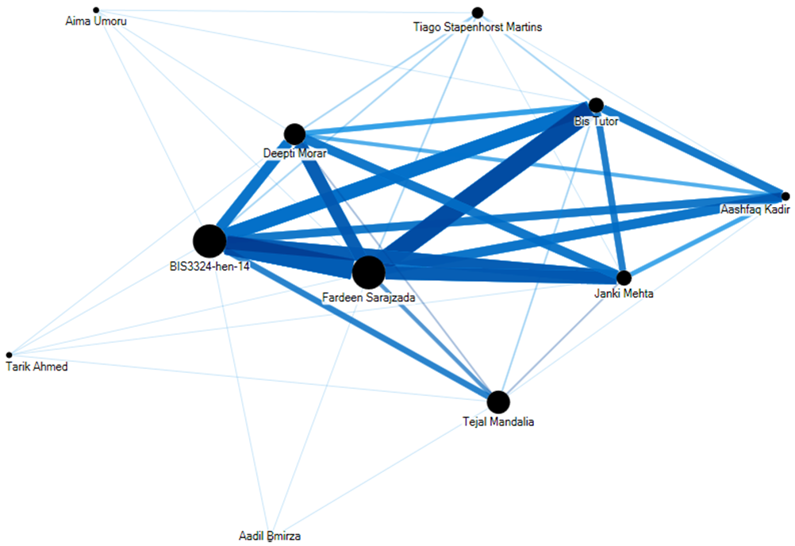
Communication with each other
BIS3324hen12
BIS3324hen14

Slide 19
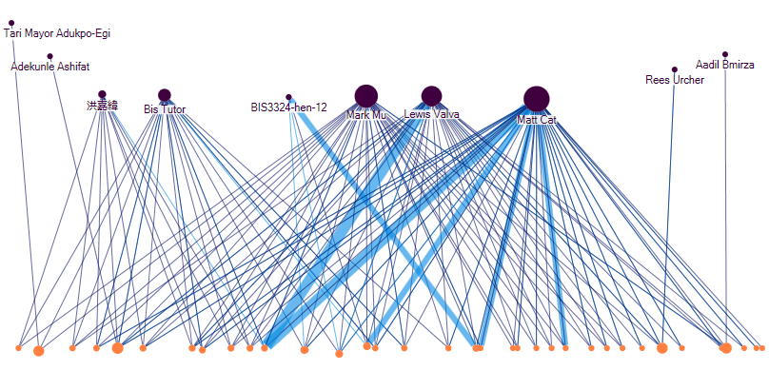
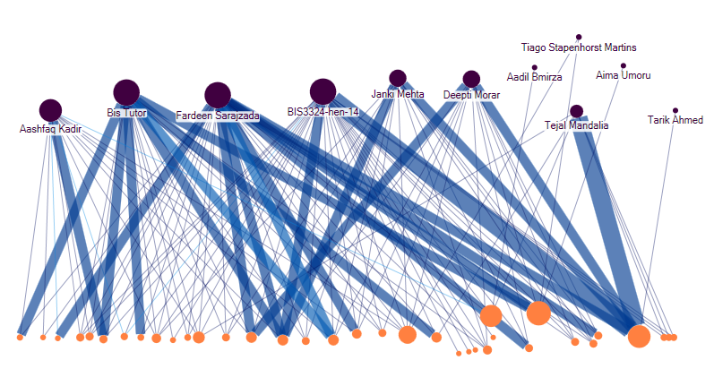
Communication with the content
BIS3324hen12
BIS3324hen14

Slide 20
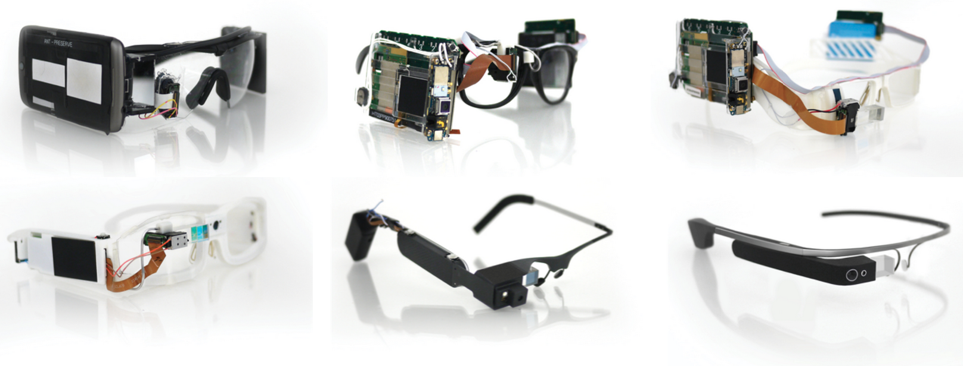
Fourth story: Google Glasses – exploring the possibilities of ubiquitous computing
Optical Head-Mounted Devices
Considering their use for
Mentoring and training
Students’ self-evaluation
Assessment and feedback

Slide 21
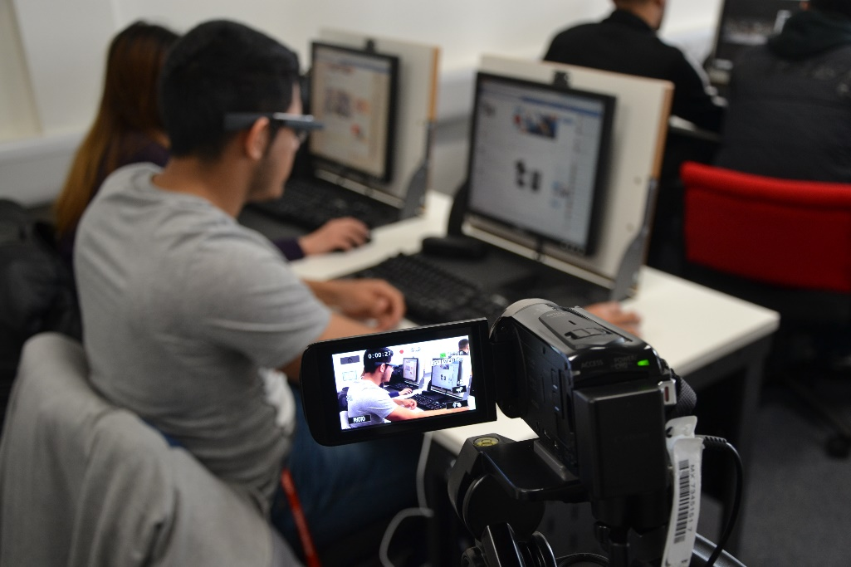
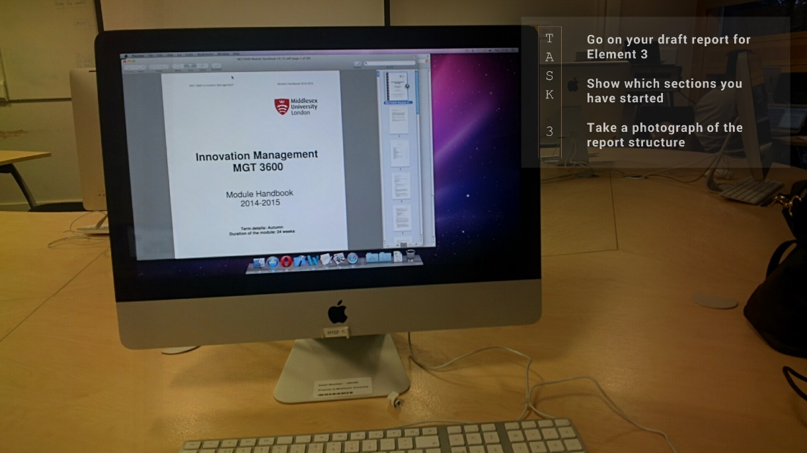
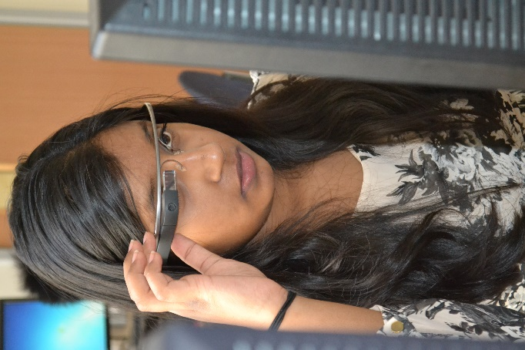
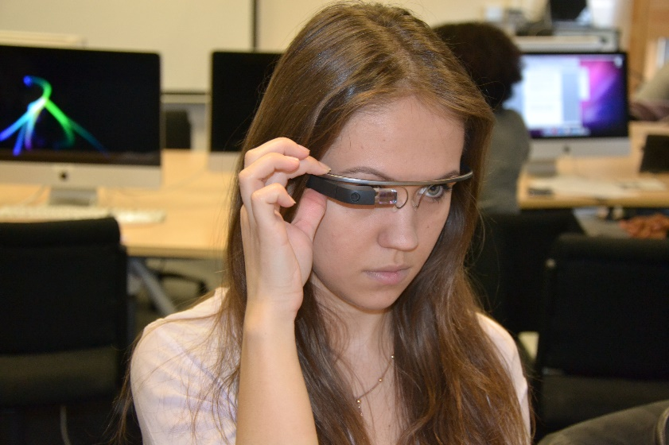
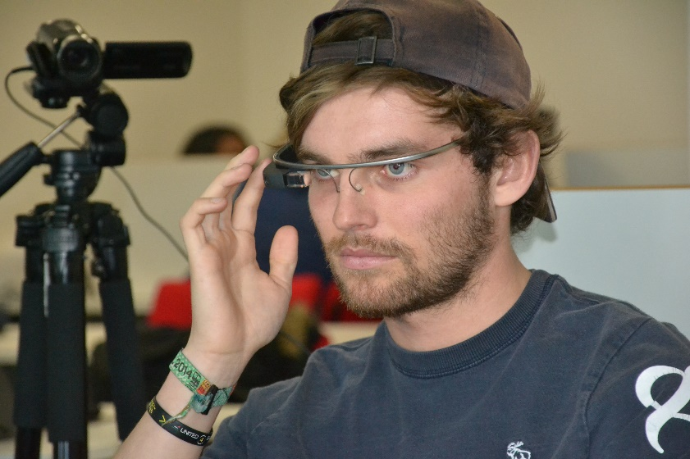
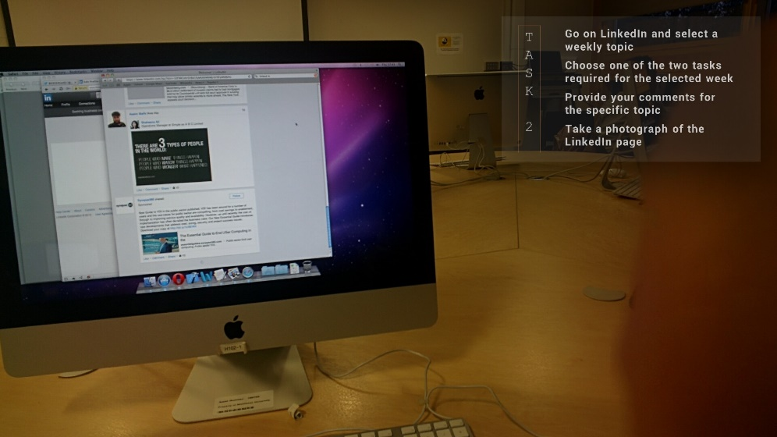
Data Collection – Part I
Taking a Picture
Recording the Session
Performing Task 3
Taking a Picture
Moving to Next Task
Performing Task 2

Slide 22
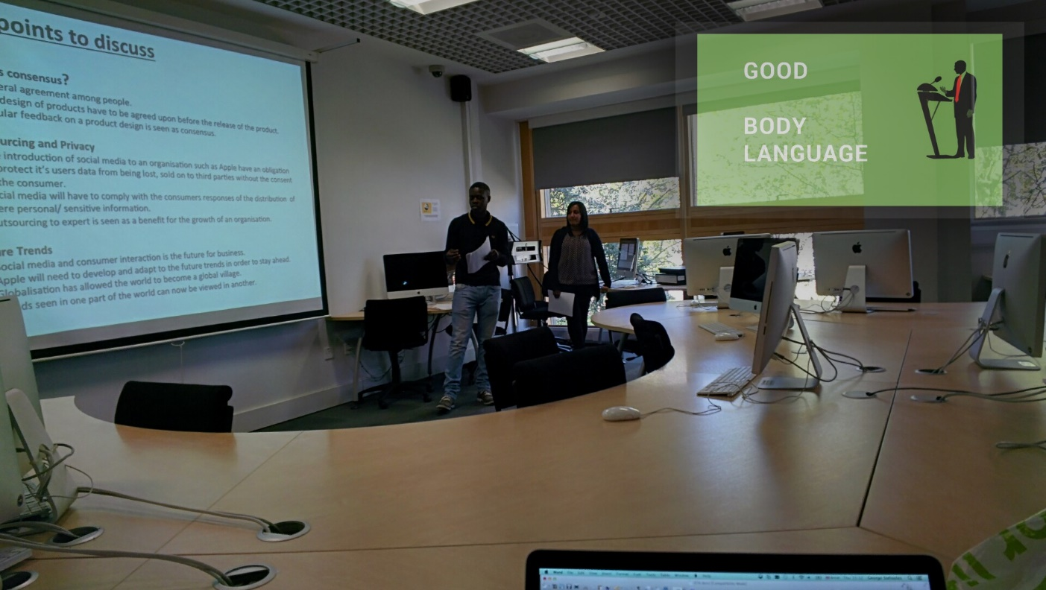
Data Collection – Part II
Bad Body Language
Good Body Language
Good Slide Content
Bad Slide Content

Slide 23
Evaluation

Slide 24
Questions
?

